Slide 1
Chapter 3 lesson 2
the Byzantine empire

Slide 2
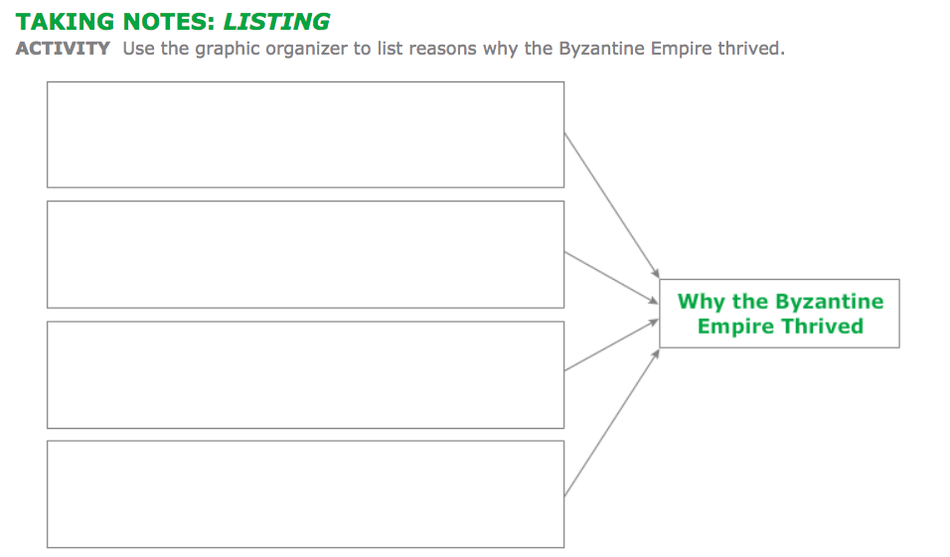
Friday’s bellwork
Draw this graphic organizer in your notebook. We will fill-in as we discuss the lesson today.

Slide 3
Chapter 3 lesson 1: Byzantine Empire
Guiding question: How did the Byzantine Empire become rich and powerful?
Video: Constantinople and Istanbul
Read and discuss lesson 2
Fill-in graphic organizer
Hw: complete study guide

Slide 4
The new rome
After the Roman Empire was divided in a.d. 395, the eastern half eventually became known as the Byzantine Empire.
At the height of its power in the a.d. 500s, the Byzantine territory extended west to Italy, south to Egypt, and east to the Arabian border.
Under Emperor Justinian, the laws improved, the arts flourished, and the empire grew dramatically.

Slide 5
Constantinople
Constantine moved the capital of the Roman Empire from Rome to the Greek city of Byzantium and renamed the city Constantinople. The new capital thrived.
By the a.d. 500s, multicultural Constantinople had become one of the world's most advanced cities.
Constantinople's location was a major factor in the city's success.
Located on a peninsula between the Black Sea and the Aegean Sea, the city's excellent harbors attracted fishing boats, trading ships, and warships.
Because of its location at the crossroads of trade routes between Europe and Asia, Constantinople became the wealthiest part of the Roman Empire.

Slide 6
Constantinople
Constantinople was also easy to defend.
Because it was located on. Peninsula, Constantinople was protected on 3 sides by the sea, and a large wall protected it’s 4th side
Surprise attacks were not easily carried out on Constantinople.
What Cultural Influences Shaped the Byzantines?
Constantinople at first resembled other cities in the Roman Empire. The "New Rome," as it was called, had government buildings and palaces built in the Roman style. The city also had an oval arena called the Hippodrome (HIHP • uh • drohm) where chariot races and other events were held.

Slide 7
What Cultural Influences Shaped the Byzantines?
Rome influenced the political and social life of the Byzantine Empire
Emperors spoke Latin and enforced Roman laws.
the government gave the empire's poor people free bread and entertainment shows.
Eventually this roman influence began to change, and Greek influences become more prominent
Most Byzantines spoke Greek, and Byzantine emperors and officials also began to speak Greek instead of Latin.
The ideas of non-Greek peoples, like the Egyptians and the Slavs, also shaped Byzantine life.
Still other customs came from Persia to the east. All of these cultures blended together to form the Byzantine civilization.

Slide 8
What Cultural Influences Shaped the Byzantines?
Between a.d. 500 and a.d. 1200, the Byzantines developed one of the world's most advanced civilizations.
They preserved and passed on Greek culture and Roman law to other peoples.
As you will learn, they also brought Christianity to people in Eastern Europe.
FA Check: Why was Constantinople important to the Byzantine Empire? (Turn and talk to an elbow partner.)

Slide 9
Justinian's Rule
How did Emperor Justinian and Empress Theodora strengthen the Byzantine Empire?
Justinian ruled the Byzantine Empire at the height of its power.
He was A skilled general and a strong leader, Justinian ruled from a.d. 527 until a.d. 565.
Many historians view Justinian as the greatest Byzantine emperor.

Slide 10
Justinian's Rule
Who Was Theodora?
Justinian's wife, the empress Theodora was a beautiful, intelligent, and ambitious woman.
She participated actively in government and helped Justinian choose government officials.
Theodora helped Byzantine women win more legal rights. At her urging, Justinian changed Byzantine law so that a wife could own land.
If a woman became a widow, her land would provide the income she needed to take care of her children.
Theodora showed her political wisdom during a crisis in a.d. 532.
When angry taxpayers in Constantinople threatened the government, Justinian's advisers urged Justinian to flee the city.
Theodora, however, told her husband to stay and fight. According to one Byzantine historian, Theodora told Justinian that she would rather die as an empress than escape and live as an outlaw
Taking Theodora's advice, Justinian stayed in the city and fought back. His army crushed the rebels. By doing this, Justinian was able to restore order and strengthen his power as emperor.

Slide 11
Justinian's Legal Reforms
One of Justinian's lasting contributions to future civilizations was in the area of law.
Shortly after he became emperor, Justinian realized that the empire's laws were disorganized and confusing.
He ordered a group of legal scholars headed by Tribonian (truh • BOH • nee • uhn) to create a simpler and better code of laws.
the group's new legal code became known as the Justinian Code. The code helped officials and businesspeople better understand the empire's laws.
Throughout the centuries, the Justinian Code has been the basis for the legal systems of almost every country in the Western world.

Slide 12
Byzantine Arts
Justinian, along with other Byzantine emperors, was interested in arts and architecture.
Among the hundreds of beautiful churches and palaces in Constantinople was the church called Hagia Sophia (HAH • jee • uh soh • FEE • uh), or "Holy Wisdom.”
the domed church became the religious center of the Byzantine Empire. The interior of Hagia Sophia contains walls of polished marble and beautiful gold and silver ornaments. This unique building still stands in Istanbul today.
Numerous mosaics also decorated the interior walls of Hagia Sophia. Mosaics are patterns or pictures made from small pieces of colored glass or stone. Popular in the Byzantine Empire, most mosaics showed figures of saints, or Christian holy people. Other mosaics, such as the one at the beginning of the chapter, honored Byzantine emperors.
In addition to the arts and architecture, Emperor Justinian was concerned about education. Learning was highly respected in the Byzantine culture.

Slide 13
Military conquest
justinian wanted to restore the Roman Empire and bring back the glory of Rome. Led by a general named Belisarius (BEH • luh • SAR • ee • uhs), the Byzantine army was strengthened and reorganized.
Between a.d. 533 and a.d. 555, the Byzantine military conquered territories that were once part of the great Roman Empire. These territories included Italy and parts of Spain and northern Africa. They also defeated the Persians, which increased the security of the eastern borders of the empire.
During the mid-500s, a deadly disease known to historians as "Justinian's Plague" swept through Asia and Europe. The plague killed millions of people, including many men in Justinian's army. The loss of so many soldiers severely weakened the Byzantine Empire's ability to fight wars.
In addition, the Byzantines did not have the money to support an army large enough to defend against the Persians in the east and protect the lands in the west. Most of the western territories that Justinian conquered were lost after his death.

